Slide 1

Structural Pattern:
Facade Pattern
00
Notes:
"Good [morning/afternoon], everyone. I am [Your Name]. Today, I will present the Facade Pattern. I will demonstrate how I used this structural pattern to refactor the Combat System in our game project, focusing on simplifying interactions and separating the UI from the logic."

Slide 2

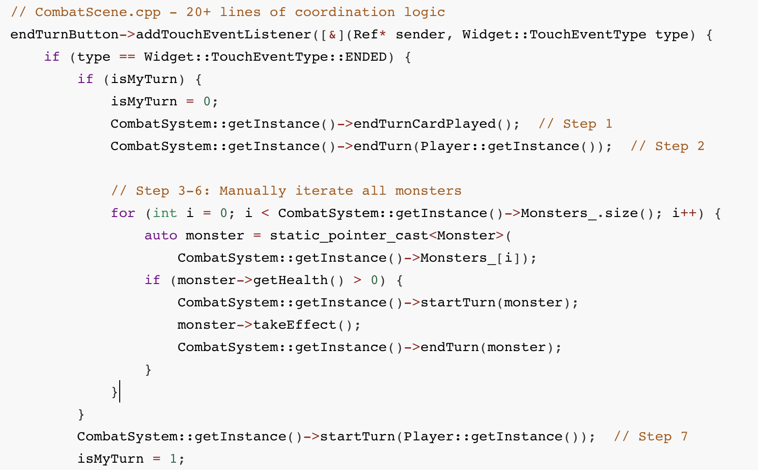
Structural Pattern: Facade Pattern
CombatSystem Refactoring
Before
Overview
The Client (CombatScene) had to interact directly with multiple complex subsystems to perform simple game operations.
Issue Before Refactoring
1.Tight Coupling: Client directly depended on CombatSystem, Player, Monster, HandPileLayer, and CreatureLayer.
2.Complex Client Logic: The client had to manage the logic sequence manually.
3.Mixed Responsibilities: Cannot know what dependencies are needed by just by looking at the class declaration
Notes:
Let's start with the problems we faced before the refactoring.
As you can see in the Overview, our Client—the CombatScene—had to interact directly with multiple complex subsystems.
This led to three major issues:
Tight Coupling: The client depended on everything: CombatSystem, Player, Monster, and the UI layers.
Complex Client Logic: Look at the code snippet on the right. To simply end a turn, the client had to write over 20 lines of code to manually iterate through monsters and manage state.
Mixed Responsibilities: It was hard to tell what dependencies were actually needed just by looking at the class declaration

Slide 3
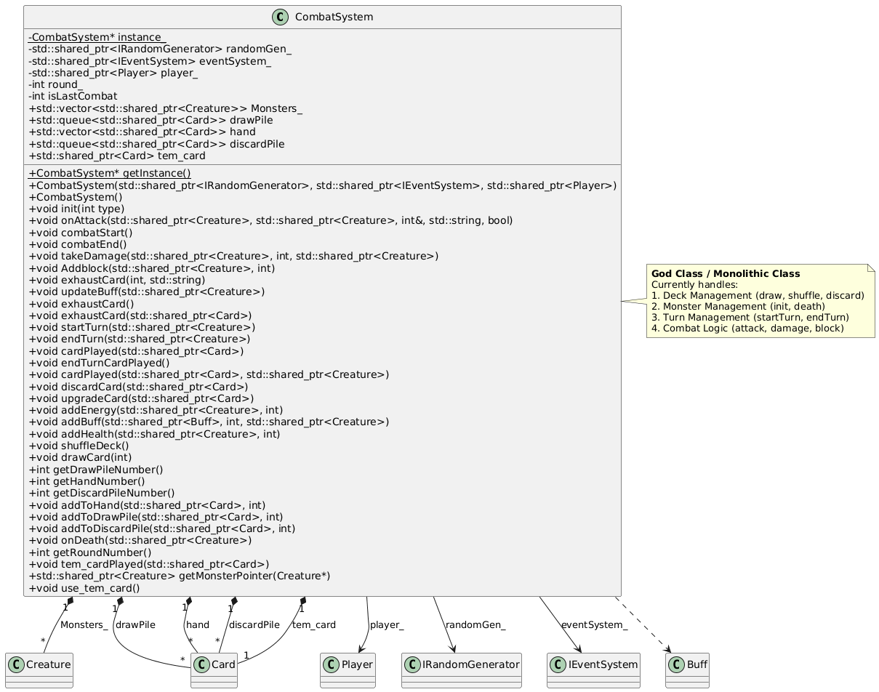
Structural Pattern: Facade Pattern
UML Changes
Before
Issues
1. Client code must call many different methods in correct order
2. CombatSystem contains both game logic AND direct UI calls
3. Cannot test game logic without instantiating Cocos2d-x UI framework
Notes:
"Here is the architecture Before the refactoring.
The CombatSystem was essentially a 'God Class' or Monolithic Class. It handled everything: Deck management, Monster management, Turn management, and Combat logic.
Crucially, it contained direct UI calls. This meant we could not unit test the game logic without instantiating the entire Cocos2d-x UI framework, which is a bad practice.

Slide 4
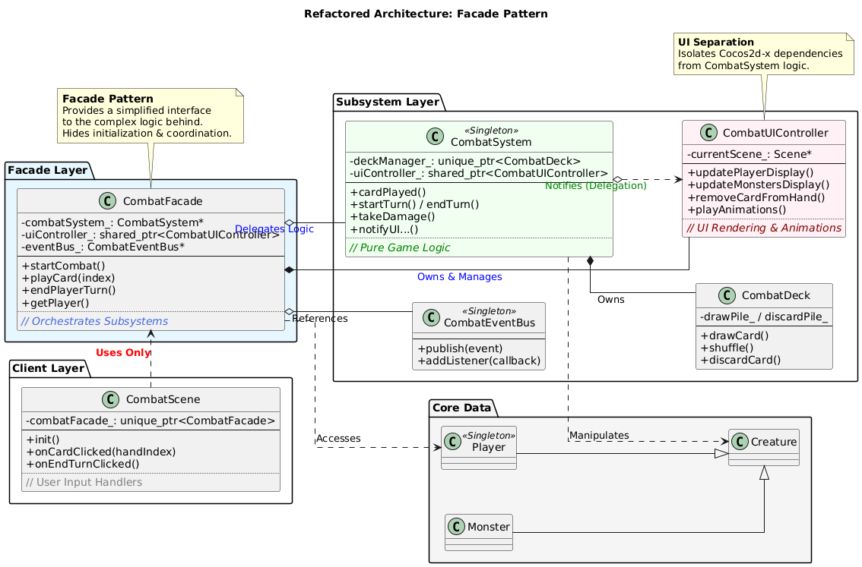
Structural Pattern: Facade Pattern
UML Changes
After
Refactor Overview
1. Simplified Interface: The Facade wraps the complexity. The client only needs to call simple methods like playCard() or endPlayerTurn().
2. Orchestration: The Facade handles the coordination between CombatSystem, UIController, and EventBus.
3. UI Separation: Extracted CombatUIController to handle all rendering, allowing CombatSystem to remain pure logic.
Notes:
Here is the architecture After applying the Facade Pattern.
We introduced the CombatFacade as a unified interface.
Three key improvements here:
Simplified Interface: The client now only depends on the Facade.
Orchestration: The Facade handles the coordination between the CombatSystem (Logic), UIController (View), and EventBus.
UI Separation: We extracted a CombatUIController. The CombatSystem is now pure logic and communicates with the UI via the controller."

Slide 5
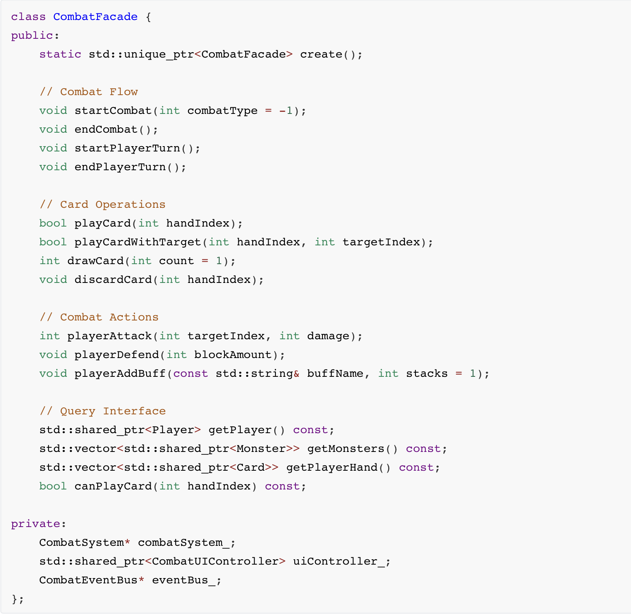
Structural Pattern: Facade Pattern
Detailed implementation
1. CombatFacade
Key Improvements
1. Facade as Orchestrator:
Clients only interact with FacadeCombatFacade coordinates between subsystems
2. UI Controller Extraction:
All Cocos2d-x specific code moved to CombatUIController
CombatSystem uses notifyUI*() methods to delegate UI updates
3. Clear separation: Logic / UI / Events
Components communicate via events (Observer pattern)
Notes:
"Let's look at the implementation details.
On the left is our CombatFacade class. You can see that it exposes high-level 'Use Cases' instead of implementation details.
For example, it provides simple methods like startCombat(), playCard(), and endPlayerTurn(). Internally, the Facade acts as an Orchestrator. It manages the CombatSystem for logic and the CombatUIController for rendering, ensuring they stay synchronized without the client needing to worry about it."

Slide 6
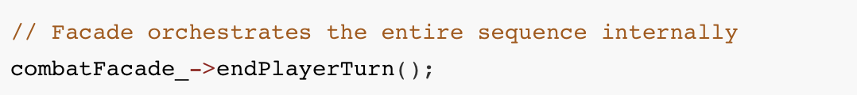
Structural Pattern: Facade Pattern
Detailed implementation
1. Code Comparison - before
2. Code Comparison - after
Overview
The CombatFacade exposes high-level "Use Cases" instead of implementation details.
Notes:
The impact on the client code is dramatic.
On the left (Before): You see the chaotic coordination logic I mentioned earlier. The client had to manually manage the monster loop and state checks.
On the right (After): The entire sequence is orchestrated internally by the Facade. The client code is reduced to a single line: combatFacade_->endPlayerTurn(). This makes the client code much cleaner and less error-prone."

Slide 7
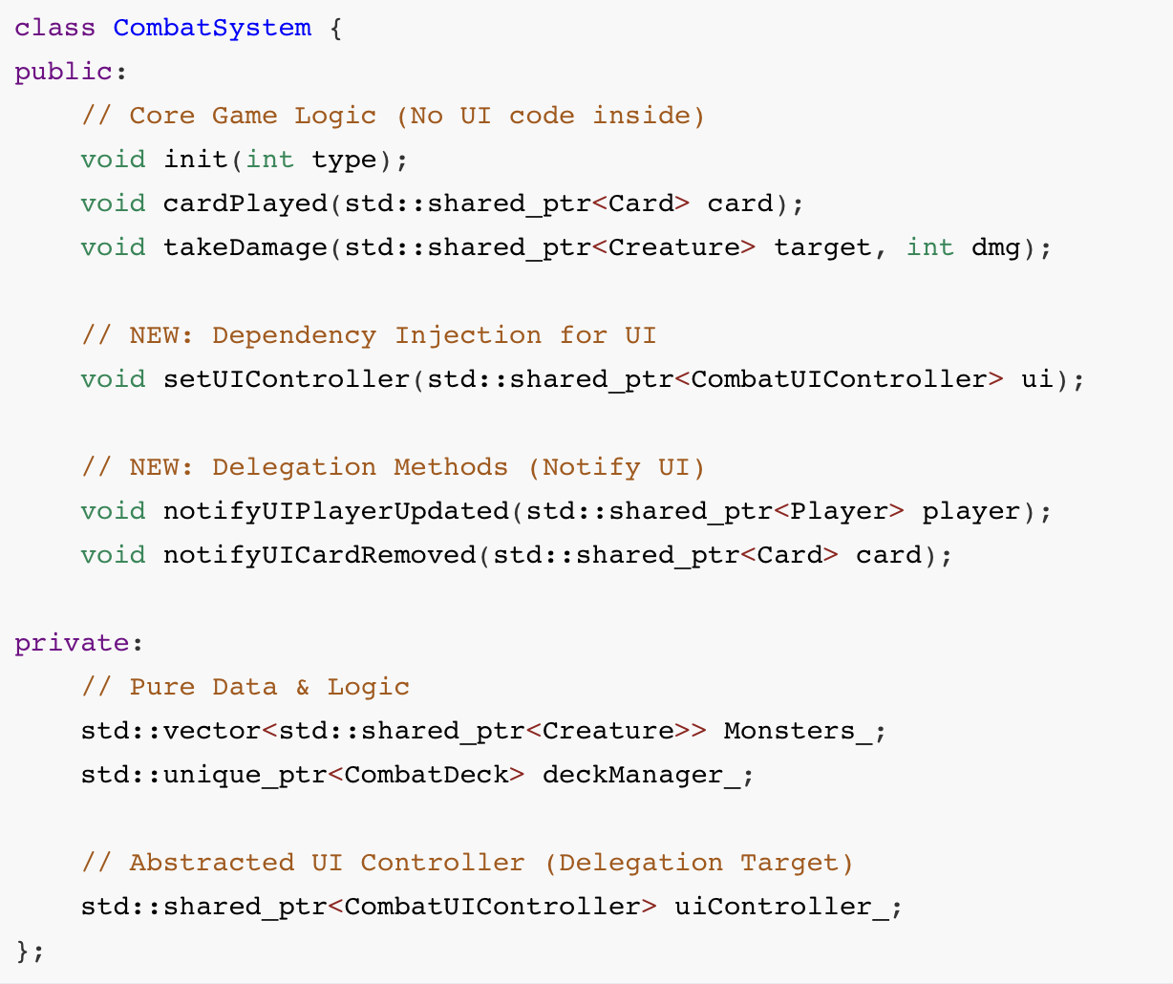
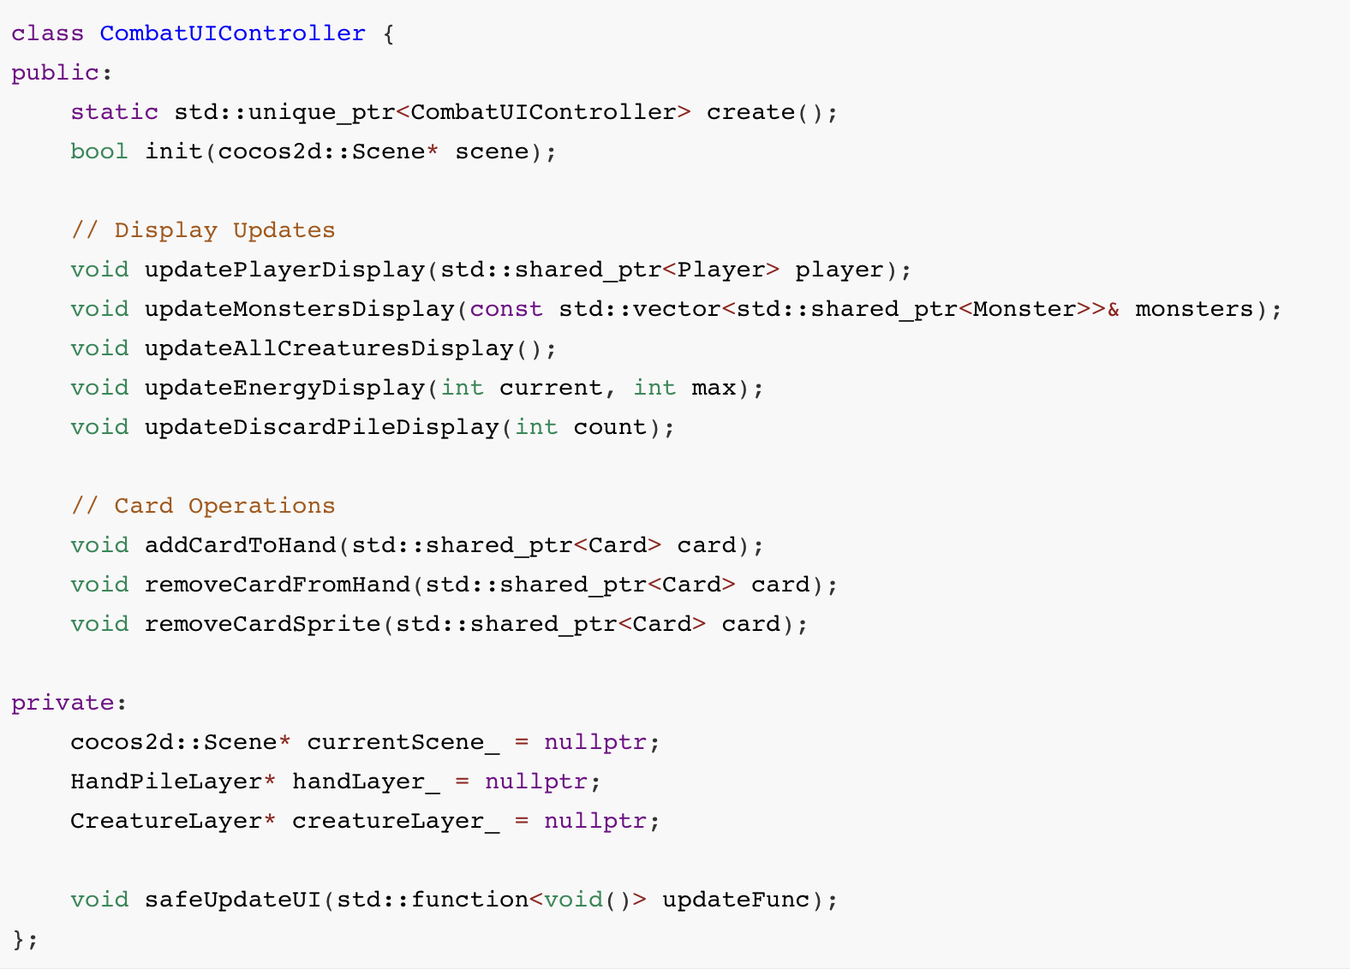
Structural Pattern: Facade Pattern
Detailed implementation
1. CombatSystem :
CombatUIController
Notes:
Finally, a major benefit of this refactoring is the Separation of Logic and UI.
On the right side, we have the CombatUIController. This class encapsulates all the Cocos2d-specific code, like updating displays and running animations.
On the left side, we have the refactored CombatSystem. It is now a Pure Logic class. Notice that it no longer creates Sprites directly. Instead, it uses Dependency Injection to hold a reference to the UI Controller.
When logic changes (like a player taking damage), it calls notifyUI... methods to delegate the rendering task. This allows us to test the logic independently.

Slide 8
Structural Pattern: Facade Pattern
Advantages
Limitations
1. Simplified Client Code:
Client complexity reduced significantly (e.g., from 20 lines to 1 line for turn ending).
2. Testability:
We can now Mock CombatUIController. This allows testing CombatSystem logic without initializing the graphics engine.
3. Loose Coupling: CombatScene no longer needs to know about internal subsystems like CombatDeck or Monster loops.
CombatSystem is still a "God Object":
The Facade wraps the complexity but hasn't decomposed the internal logic of CombatSystem yet.
Abstraction Overhead:
Added ~1000 lines of code (Facade + UIController + EventBus) to establish the structure.
Notes:
To conclude, let's review the trade-offs.
Advantages:
Simplified Client Code: We reduced complexity from 20 lines to 1 line for common operations.
Testability: By mocking the CombatUIController, we can now unit test the CombatSystem logic without the graphics engine.
Loose Coupling: The Client no longer needs to know about internal subsystems.
Limitations: We must be honest that the CombatSystem is still essentially a 'God Object' internally. The Facade wraps the complexity but hasn't fully decomposed the internal logic yet. Also, this architecture added some abstraction overhead.
However, for the purpose of improving client interaction and enabling testing, this was a highly successful refactoring.

